Slide 1
CSE 417T Introduction to Machine Learning
Lecture 10 Instructor: Chien-Ju (CJ) Ho

Slide 2
Logistics
Homework 2: due on Mar 8, Monday
Exam 1: Mar 23 (Tuesday)
No class next Tuesday (Wellness day)

Slide 3
Recap

Slide 4
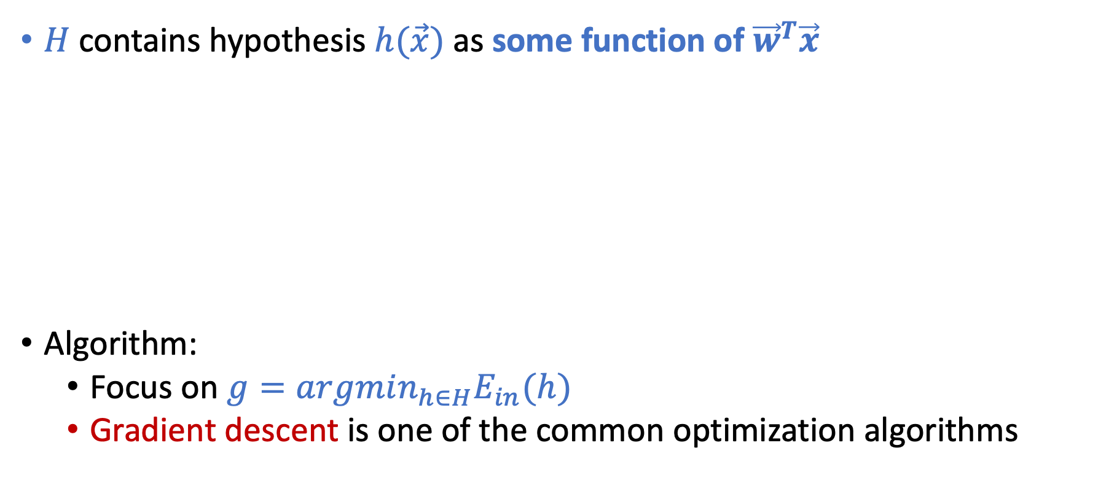
Linear Models
This is why it’s called linear models
$H$ contains hypothesis $h(\vec{x})$ as some function of ${\vec{w}}^{T}\vec{x}$
Algorithm:
Focus on $g=argmin_{h∈H}E_{in}(h)$
Gradient descent is one of the common optimization algorithms

Slide 5
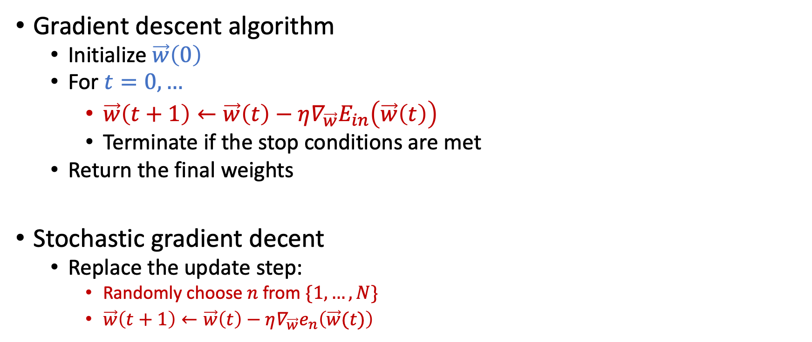
Gradient Descent
Gradient descent algorithm
Initialize $\vec{w}\left(0\right)$
For $t=0,…$
$\vec{w}\left(t+1\right)←\vec{w}\left(t\right)−η∇_{\vec{w}}E_{in}\left(\vec{w}\left(t\right)\right)$
Terminate if the stop conditions are met
Return the final weights
Stochastic gradient decent
Replace the update step:
Randomly choose $n$ from $\{1,…,N\}$
$\vec{w}\left(t+1\right)←\vec{w}\left(t\right)−η∇_{\vec{w}}e_{n}\left(\vec{w}(t)\right)$
Works for functions where gradient exists everywhere

Slide 6
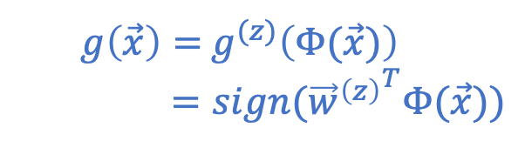
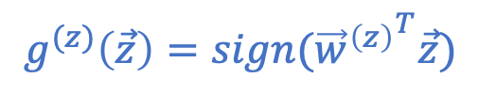
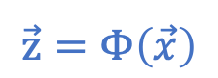
Nonlinear Transformation
$$\vec{z}=Φ\left(\vec{x}\right)$$
$$g^{(z)}\left(\vec{z}\right)=sign({{\vec{w}}^{\left(z\right)}}^{T}\vec{z})$$
$g\left(\vec{x}\right)=$ $g^{(z)}\left(Φ(\vec{x})\right)$
$=sign({{\vec{w}}^{\left(z\right)}}^{T}Φ(\vec{x}))$

Slide 7
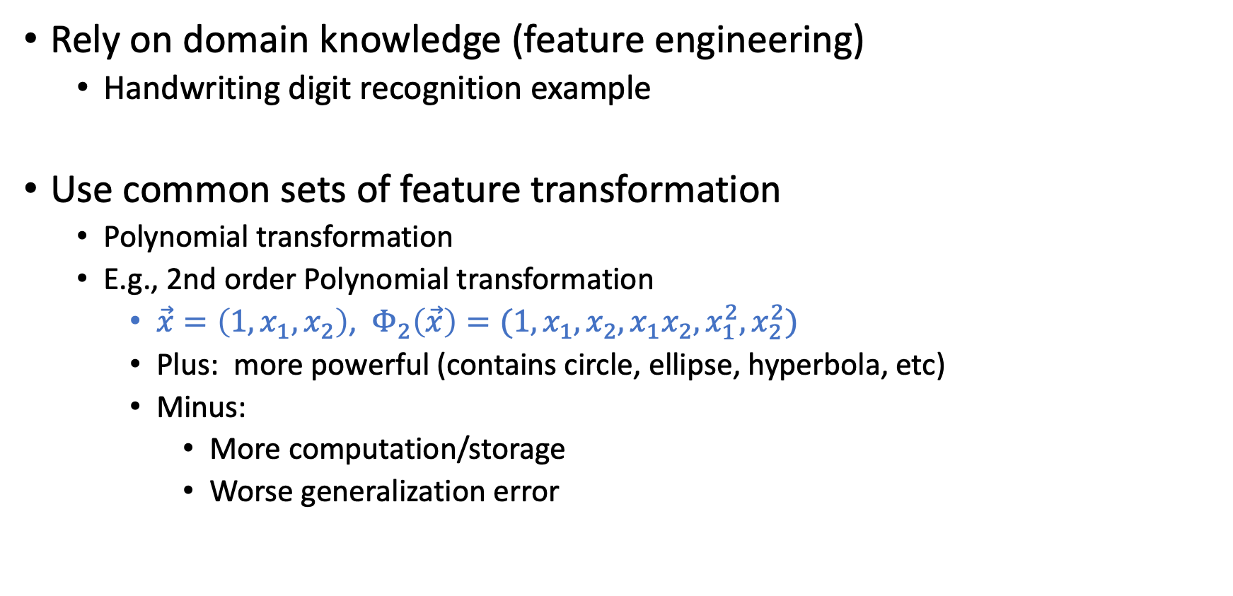

Must Choose $Φ$ BEFORE Looking at the Data
Rely on domain knowledge (feature engineering)
Handwriting digit recognition example
Use common sets of feature transformation
Polynomial transformation
E.g., 2nd order Polynomial transformation
$\vec{x}=\left(1,x_{1},x_{2}\right)$, $Φ_{2}\left(\vec{x}\right)=(1,x_{1},x_{2},x_{1}x_{2},x_{1}^{2},x_{2}^{2})$
Plus: more powerful (contains circle, ellipse, hyperbola, etc)
Minus:
More computation/storage
Worse generalization error
The VC dimension of d-dim perceptron is d+1

Slide 8
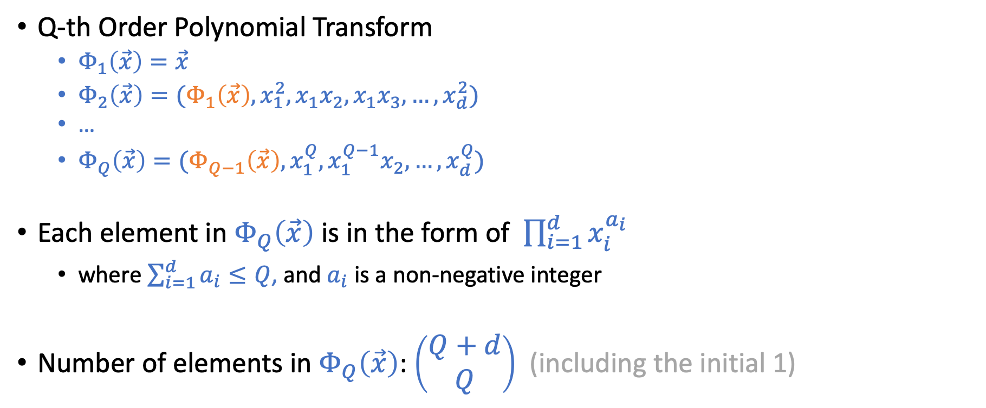
Q-th Order Polynomial Transform
Q-th Order Polynomial Transform
$Φ_{1}\left(\vec{x}\right)=\vec{x}$
$Φ_{2}\left(\vec{x}\right)=(Φ_{1}\left(\vec{x}\right),x_{1}^{2},x_{1}x_{2},x_{1}x_{3},…,x_{d}^{2})$
…
$Φ_{Q}\left(\vec{x}\right)=(Φ_{Q−1}\left(\vec{x}\right),x_{1}^{Q},x_{1}^{Q−1}x_{2},…,x_{d}^{Q})$
Each element in $Φ_{Q}\left(\vec{x}\right)$ is in the form of $\prod_{i=1}^{d}{x_{i}^{a_{i}}}$
where $\sum_{i=1}^{d}{a_{i}}≤Q$, and $a_{i}$ is a non-negative integer
Number of elements in $Φ_{Q}\left(\vec{x}\right)$: $\left(\begin{matrix}Q+d \\ Q\end{matrix}\right)$ (including the initial 1)

Slide 9
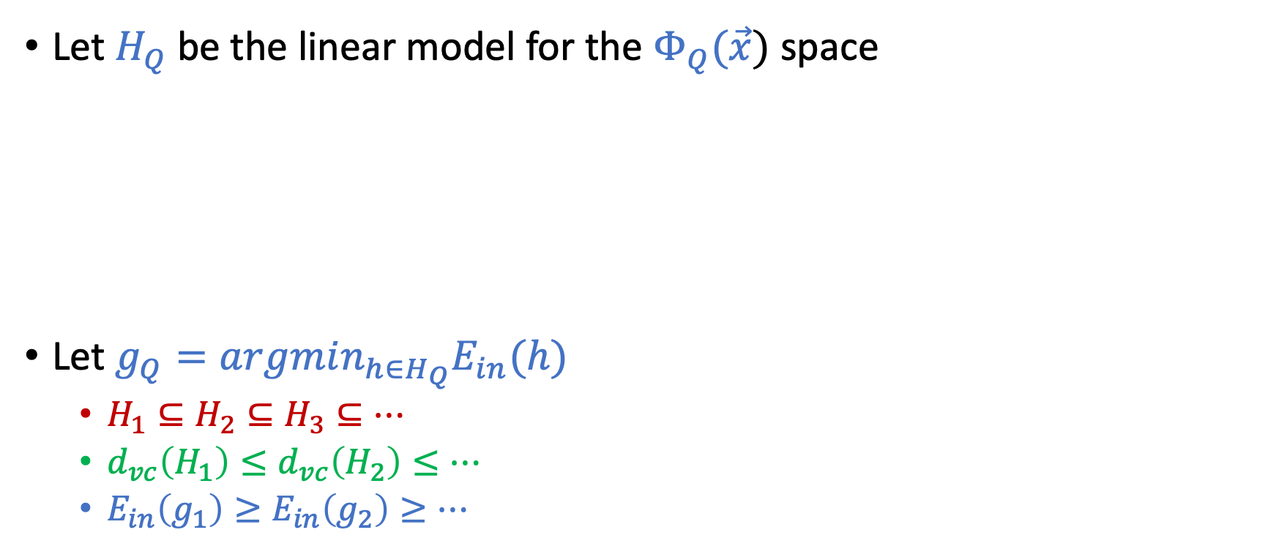
Structural Hypothesis Sets
Let $H_{Q}$ be the linear model for the $Φ_{Q}(\vec{x})$ space
Let $g_{Q}=argmin_{h∈H_{Q}}E_{in}(h)$
$H_{1}⊆H_{2}⊆H_{3}⊆…$
$d_{vc}\left(H_{1}\right)≤d_{vc}\left(H_{2}\right)≤…$
$E_{in}\left(g_{1}\right)≥E_{in}\left(g_{2}\right)≥…$

Slide 10
Today’s Lecture
The notes are not intended to be comprehensive. They should be accompanied by lectures and/or textbook.
Let me know if you spot errors.

Slide 11
Overfitting
[Adapted from the slides by Malik Magdon-Ismail]

Slide 12
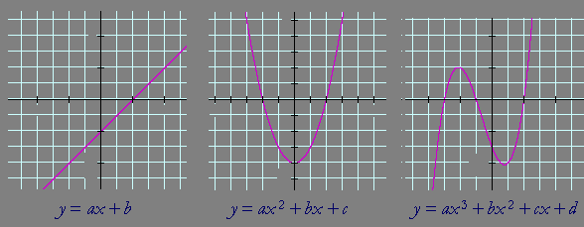
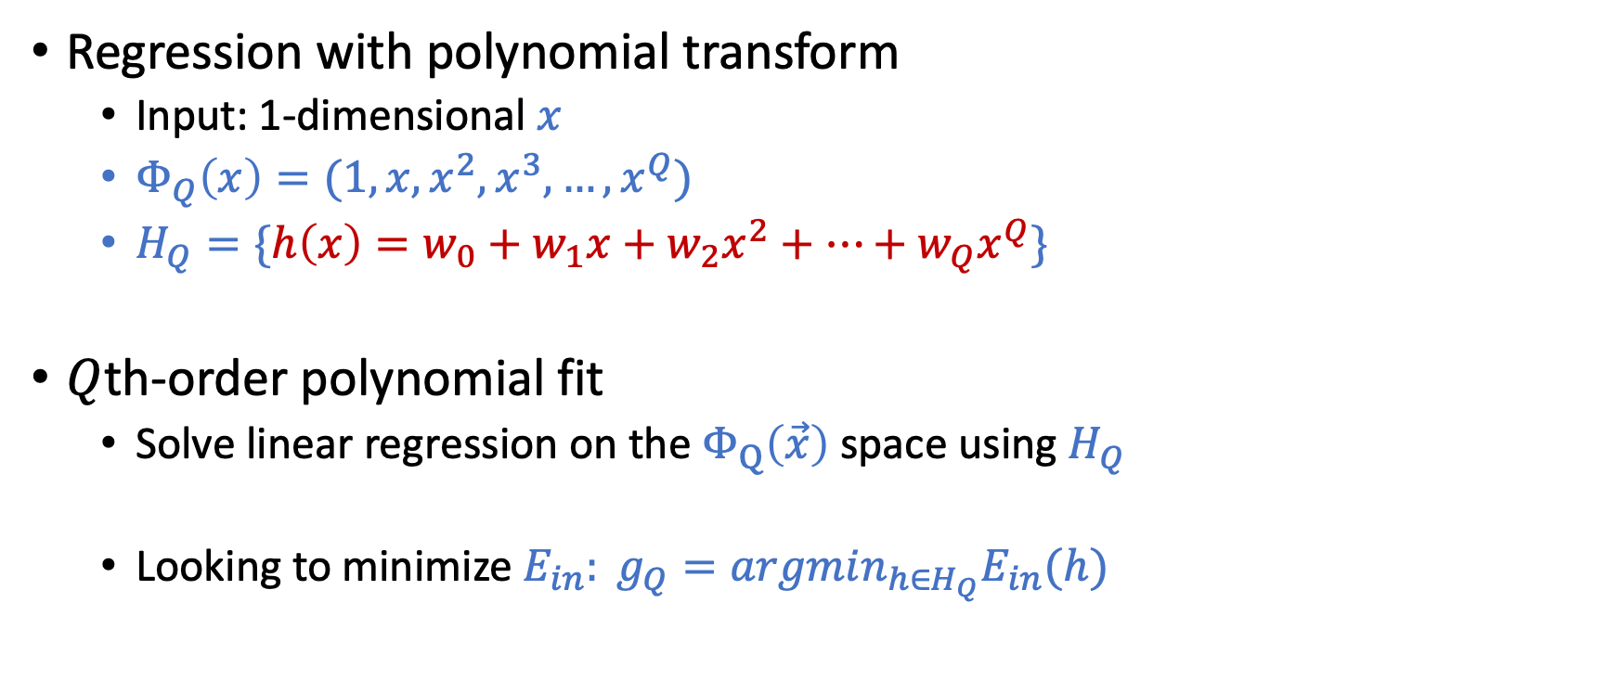
Setup of the Discussion
Regression with polynomial transform
Input: 1-dimensional $x$
$Φ_{Q}\left(x\right)=(1,x,x^{2},x^{3},…,x^{Q})$
$H_{Q}=\{h\left(x\right)=w_{0}+w_{1}x+w_{2}x^{2}+…+w_{Q}x^{Q}\}$
$Q$th-order polynomial fit
Solve linear regression on the $Φ_{Q}\left(\vec{x}\right)$ space using $H_{Q}$
Looking to minimize $E_{in}: g_{Q}=argmin_{h∈H_{Q}}E_{in}(h)$

Slide 13
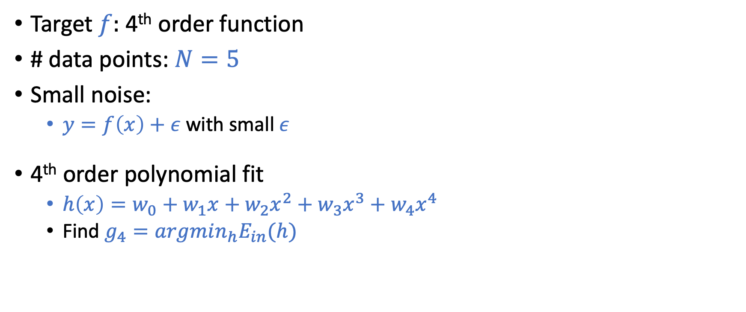
A Simple Example
Target $f:$ 4th order function
# data points: $N=5$
Small noise:
$y=f\left(x\right)+ε$ with small $ε$
4th order polynomial fit
$h\left(x\right)=w_{0}+w_{1}x+w_{2}x^{2}+w_{3}x^{3}+w_{4}x^{4}$
Find $g_{4}=argmin_{h}E_{in}(h)$

Slide 14
A Simple Example
Target $f:$ 4th order function
# data points: $N=5$
Small noise:
$y=f\left(x\right)+ε$ with small $ε$
4th order polynomial fit
$h\left(x\right)=w_{0}+w_{1}x+w_{2}x^{2}+w_{3}x^{3}+w_{4}x^{4}$
Find $g_{4}=argmin_{h}E_{in}(h)$
Classical overfitting: $E_{in}=0,$ but lead to a large $E_{out}$
Fitting the noise instead of the target

Slide 15
What is Overfitting?
Fitting the data more than is warranted

Slide 16
Overfitting is Not Just Bad Generalization

Slide 17

Overfitting is Not Just Bad Generalization
Overfitting
Going for lower and lower $E_{in}$ results in higher and higher $E_{out}$

Slide 18
Case Study: 2nd vs 10th Order Polynomial Fit

Slide 19
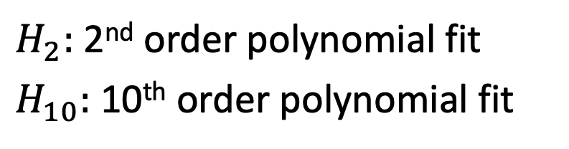
N=15
$H_{2}:$ 2nd order polynomial fit
$H_{10}:$ 10th order polynomial fit
Which model do you choose for the left problem and why?

Slide 20

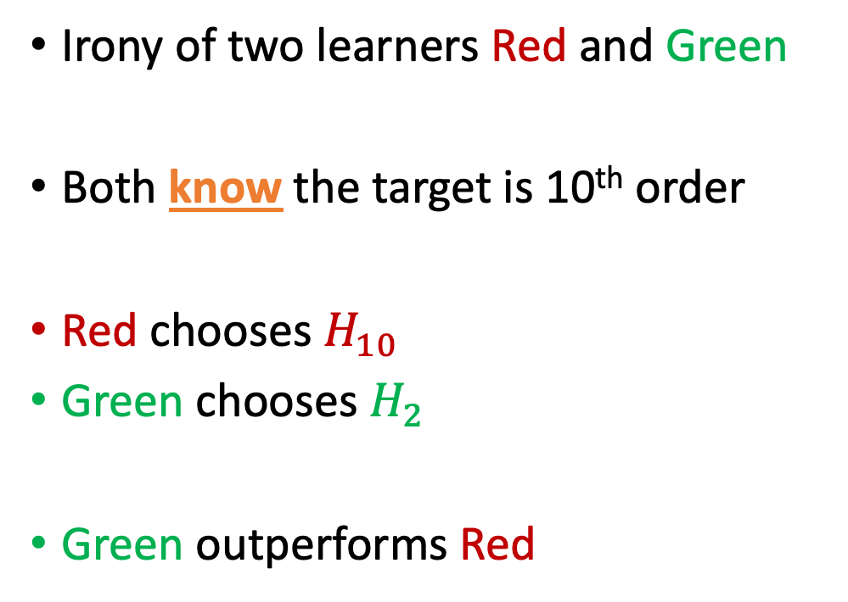
Target Function: 10th Order $f$ with Noise
Irony of two learners Red and Green
Both know the target is 10th order
Red chooses $H_{10}$
Green chooses $H_{2}$
Green outperforms Red

Slide 21


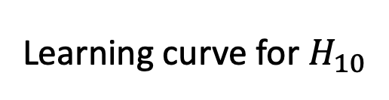
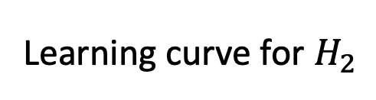
Why is $H_{2}$ Better than $H_{10}$?
Learning curve for $H_{2}$
Learning curve for $H_{10}$
When $N$ is small, $E_{out}\left(g_{10}\right)≥E_{out}(g_{2})$

Slide 22
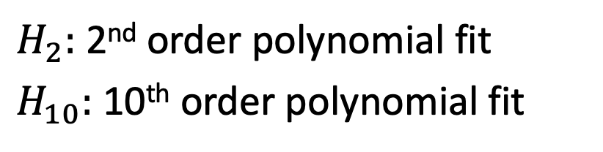
N=15
$H_{2}:$ 2nd order polynomial fit
$H_{10}:$ 10th order polynomial fit
Which model do you choose for the right problem and why?

Slide 23

Simpler $H$ is better even for complex target with no noise

Slide 24
Is There Really “No Noise”?

Slide 25
Is There Really “No Noise”?
$H$ should match quantity and quality of data, not $\left(unknown\right)f$

Slide 26
Why is $H_{2}$ Better than $H_{10}$?
Learning curve for $H_{2}$
Learning curve for $H_{10}$
When $N$ is small, $E_{out}\left(g_{10}\right)≥E_{out}(g_{2})$

Slide 27
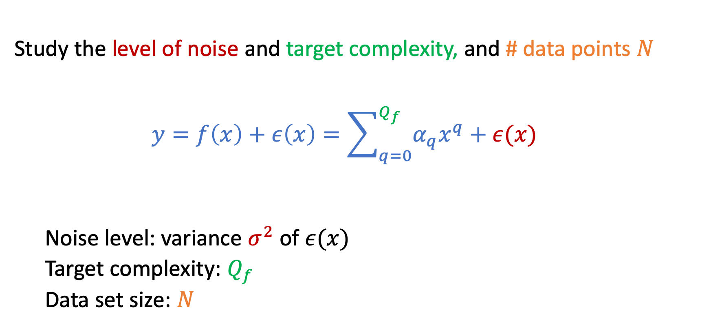
A Detailed Experiment
Study the level of noise and target complexity, and # data points $N$
$$y=f\left(x\right)+ε\left(x\right)=\sum_{q=0}^{Q_{f}}{α_{q}x^{q}+ε(x)}$$
Noise level: variance $σ^{2}$ of $ε(x)$
Target complexity: $Q_{f}$
Data set size: $N$

Slide 28
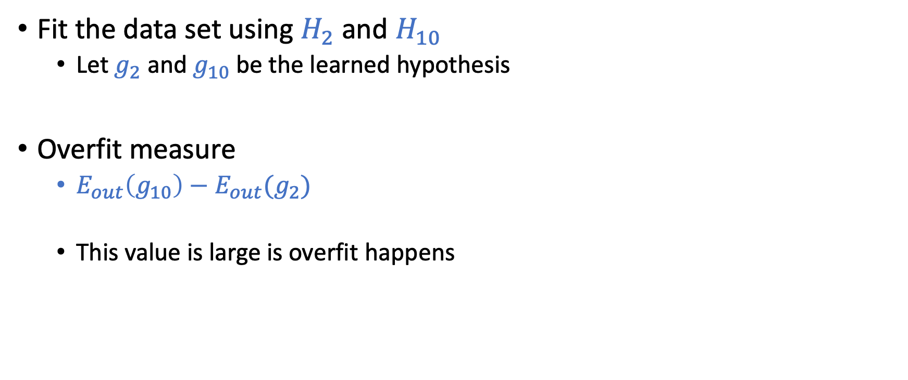
The Overfit Measure
Fit the data set using $H_{2}$ and $H_{10}$
Let $g_{2}$ and $g_{10}$ be the learned hypothesis
Overfit measure
$E_{out}\left(g_{10}\right)−E_{out}(g_{2})$
This value is large is overfit happens

Slide 29

Overfit Measure: $E_{out}\left(g_{10}\right)−E_{out}(g_{2})$
Stochastic noise
deterministic noise

Slide 30
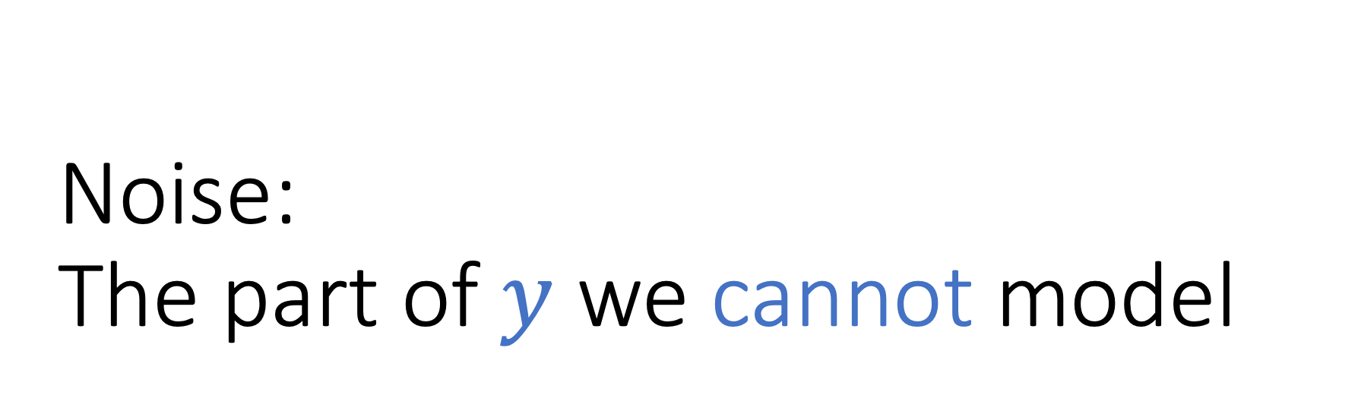
Noise: The part of $y$ we cannot model

Slide 31
Stochastic Noise

Slide 32
Stochastic Noise

Slide 33
Deterministic Noise

Slide 34
Deterministic Noise

Slide 35
Both sources of noises hurt learning

Slide 36
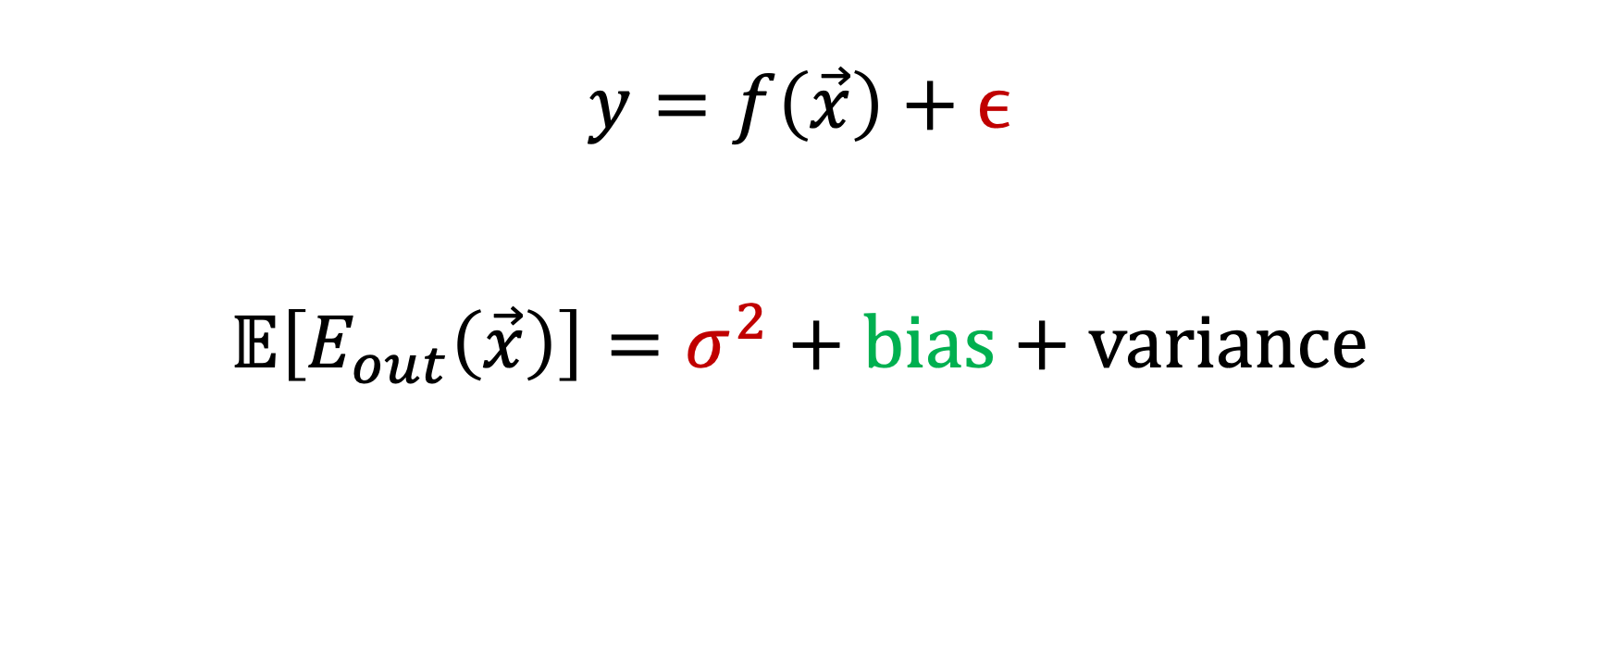
Noise and Bias-Variance Decomposition
$$y=f\left(\vec{x}\right)+ϵ$$
$$𝔼\left[E_{out}\left(\vec{x}\right)\right]=σ^{2}+\text{bias}+\text{variance}$$
Stochastic Noise
Deterministic noise

Slide 37
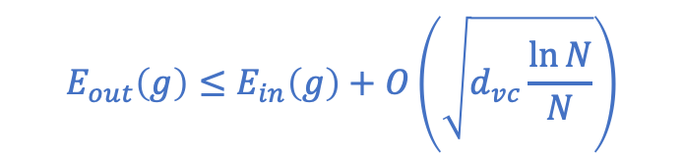
How to Fight Overfitting
VC Bound
Fighting overfitting
Regularization
Validation
(The focus of the next two lectures)
$$E_{out}\left(g\right)≤E_{in}\left(g\right)+O\left(\sqrt{d_{vc}\frac{\ln{N}}{N}}\right)$$

Slide 38
VC Dimension of d-dim Perceptron

Slide 39
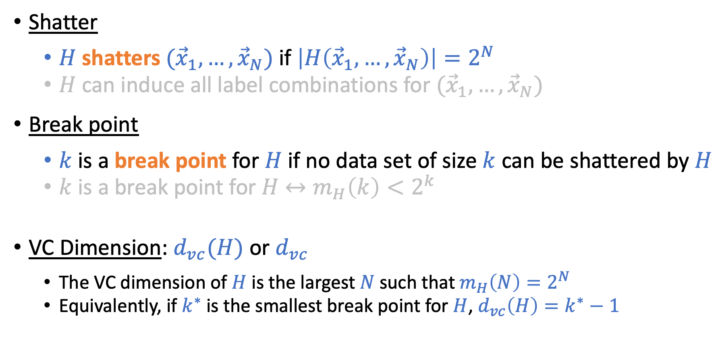
Recall the Definitions
Shatter
$H$ shatters $({\vec{x}}_{1},…,{\vec{x}}_{N})$ if $\left|H\left({\vec{x}}_{1},…,{\vec{x}}_{N}\right)\right|=2^{N}$
$H$ can induce all label combinations for $({\vec{x}}_{1},…,{\vec{x}}_{N})$
Break point
$k$ is a break point for $H$ if no data set of size $k$ can be shattered by $H$
$k$ is a break point for $H$ $↔m_{H}\left(k\right)<2^{k}$
VC Dimension: $d_{vc}(H)$ or $d_{vc}$
The VC dimension of $H$ is the largest $N$ such that $m_{H}\left(N\right)=2^{N}$
Equivalently, if $k^{∗}$ is the smallest break point for $H$, $d_{vc}\left(H\right)=k^{∗}−1$

Slide 40
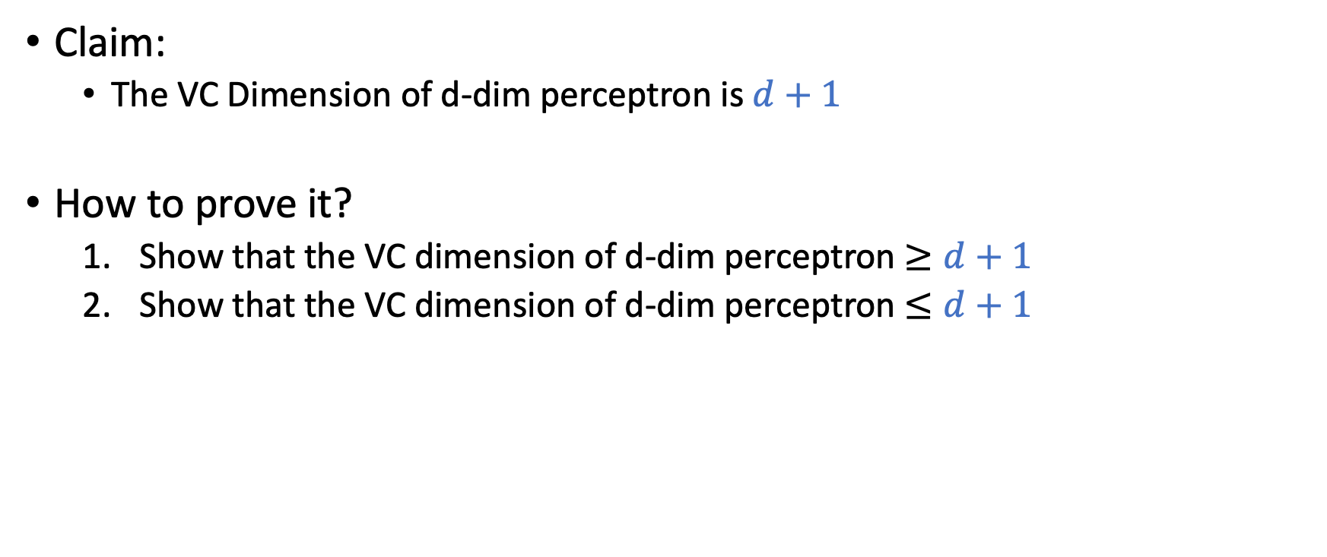
VC Dimension of d-dimension Perceptron
Claim:
The VC Dimension of d-dim perceptron is $d+1$
How to prove it?
Show that the VC dimension of d-dim perceptron $≥d+1$
Show that the VC dimension of d-dim perceptron $≤d+1$

Slide 41
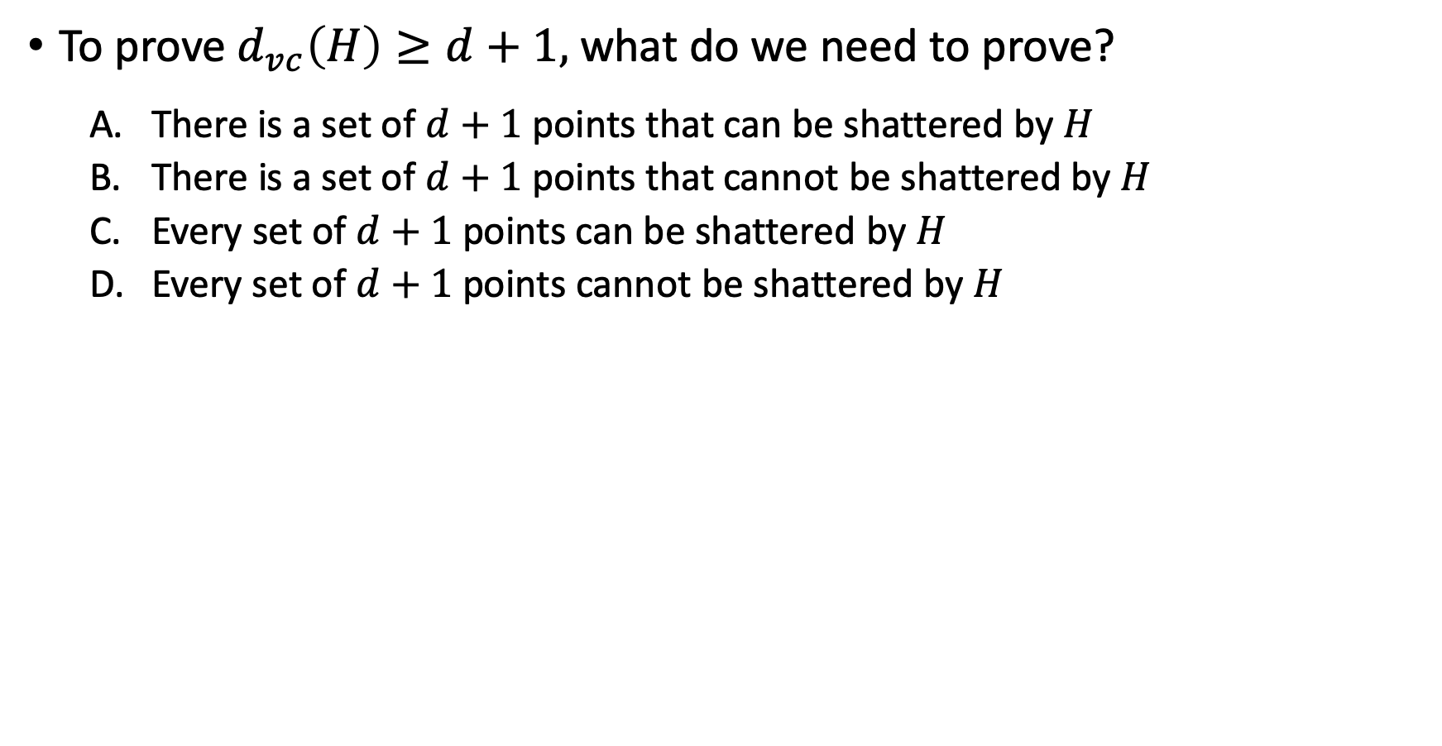
To prove $d_{vc}\left(H\right)≥d+1,$ what do we need to prove?
There is a set of $d+1$points that can be shattered by $H$
There is a set of $d+1$points that cannot be shattered by $H$
Every set of $d+1$ points can be shattered by $H$
Every set of $d+1$ points cannot be shattered by $H$

Slide 42
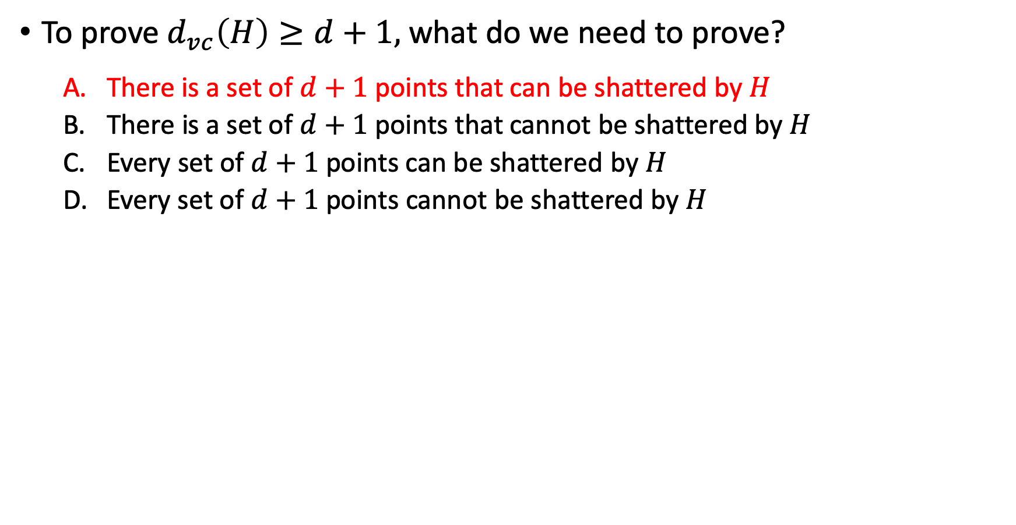
To prove $d_{vc}\left(H\right)≥d+1,$ what do we need to prove?
There is a set of $d+1$points that can be shattered by $H$
There is a set of $d+1$points that cannot be shattered by $H$
Every set of $d+1$ points can be shattered by $H$
Every set of $d+1$ points cannot be shattered by $H$

Slide 43
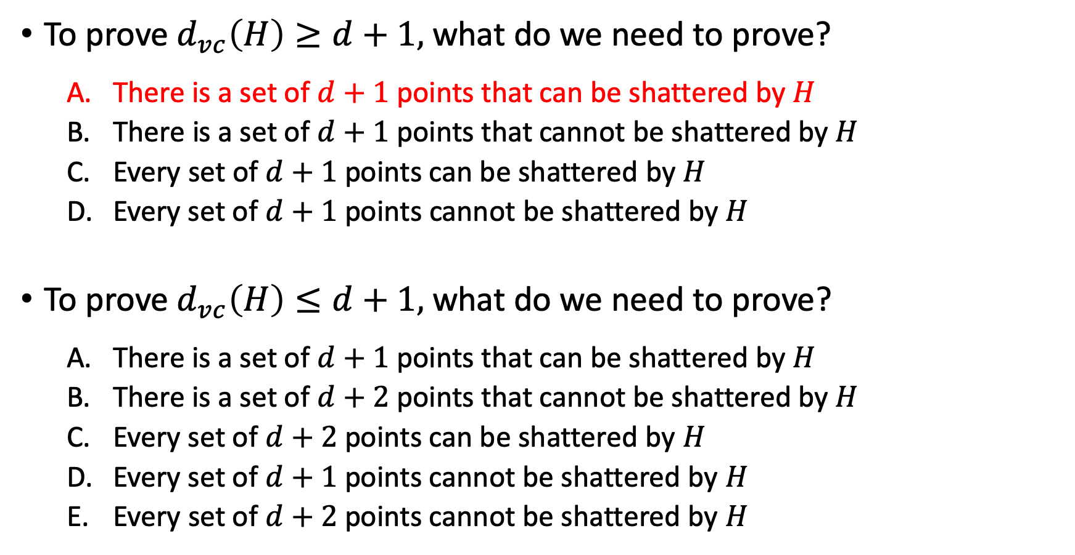
To prove $d_{vc}\left(H\right)≥d+1,$ what do we need to prove?
There is a set of $d+1$points that can be shattered by $H$
There is a set of $d+1$points that cannot be shattered by $H$
Every set of $d+1$ points can be shattered by $H$
Every set of $d+1$ points cannot be shattered by $H$
To prove $d_{vc}\left(H\right)≤d+1,$ what do we need to prove?
There is a set of $d+1$points that can be shattered by $H$
There is a set of $d+2$points that cannot be shattered by $H$
Every set of $d+2$ points can be shattered by $H$
Every set of $d+1$ points cannot be shattered by $H$
Every set of $d+2$ points cannot be shattered by $H$

Slide 44
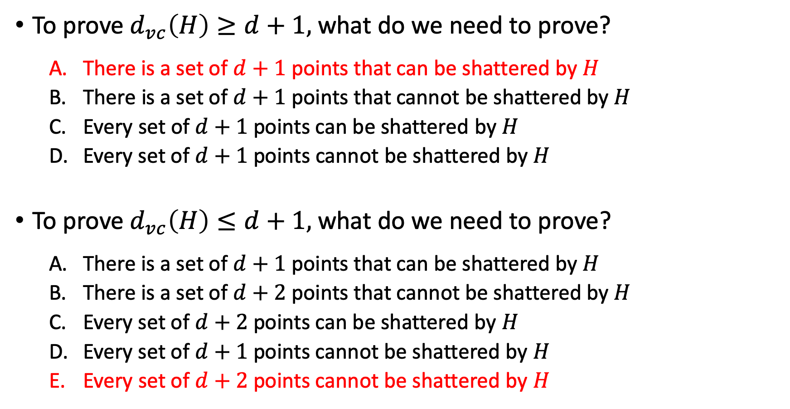
To prove $d_{vc}\left(H\right)≥d+1,$ what do we need to prove?
There is a set of $d+1$points that can be shattered by $H$
There is a set of $d+1$points that cannot be shattered by $H$
Every set of $d+1$ points can be shattered by $H$
Every set of $d+1$ points cannot be shattered by $H$
To prove $d_{vc}\left(H\right)≤d+1,$ what do we need to prove?
There is a set of $d+1$points that can be shattered by $H$
There is a set of $d+2$points that cannot be shattered by $H$
Every set of $d+2$ points can be shattered by $H$
Every set of $d+1$ points cannot be shattered by $H$
Every set of $d+2$ points cannot be shattered by $H$

Slide 45
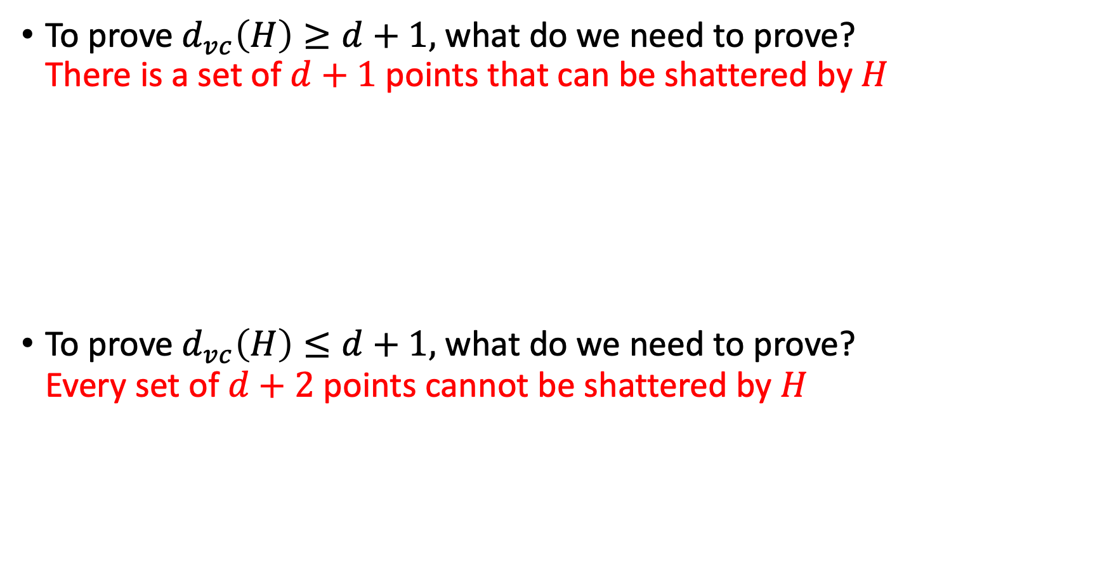
To prove $d_{vc}\left(H\right)≥d+1,$ what do we need to prove? There is a set of $d+1$points that can be shattered by $H$
To prove $d_{vc}\left(H\right)≤d+1,$ what do we need to prove? Every set of $d+2$ points cannot be shattered by $H$

